Slide 1
BASIC PROGRAMMING IN C
File processing
Indra Dwi Rianto, S.Kom, S.Si, M.T.I. (indra.rianto@binus.edu)

Slide 2

Outline
Materi Basic Programming in C - File Processing
http://bit.ly/3Guoopf
Files and Streams
Buffer Area
Open File
Close File
Input & Output File
Program Examples
Exercise

Slide 3
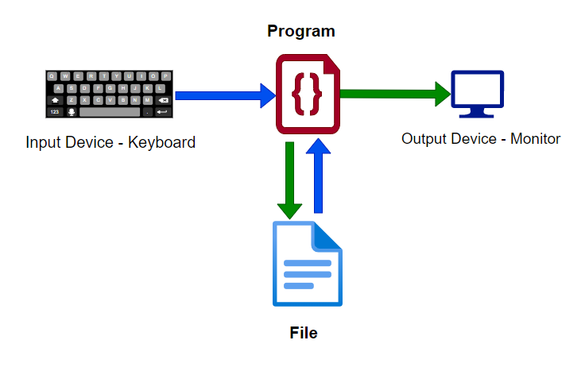
Files and Streams
stdin
stdout
stderr
FILE
Sumber Gambar

Slide 4
Files and Streams
When a C program run, there are three (3) standard streams activated:
1. Standard Input Stream
Controlling input stream from keyboard
2. Standard Output Stream
Controlling output stream to the monitor
3. Standard Error Stream
Controlling the error messaging
Each stream associated with a file.
Opening a file ordering a pointer returned to the initiator. The Pointer is pointing to a data structure with FILE type defined in stdio.h
Standard input stream
Standard output stream
Standard error stream
stdin
stdout
stderr
Stream
File pointer

Slide 5
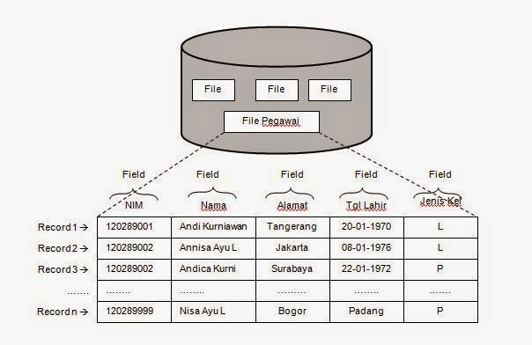
Files and Streams
  File Definition
  File is a collection of record
  Record is a collection of field
  Field is a block of byte
  Byte is collection of bit
Sumber Gambar
Notes:
https://maulahashina.wordpress.com/2015/12/13/mengetahui-field-dan-record-dalam-database/

Slide 6
Files and Streams
typedef struct {
int level; // fill/empty level of buffer
unsigned flags; // File status flags
char fd; // File descriptor
unsigned char hold; // Unget char if no buffer
int bsize; // Buffer size
unsigned char *buffer; // Data transfer buffer
unsigned char *curp; // Current active pointer
unsigned istemp; // Temporary file indicator
short token; //Used for validity checking
} FILE;
Notes:
https://maulahashina.wordpress.com/2015/12/13/mengetahui-field-dan-record-dalam-database/

Slide 7
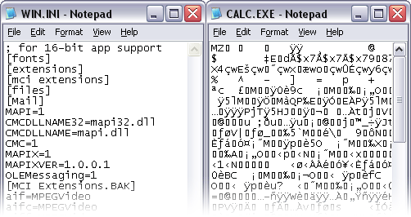
Files and Streams
TEXT FILE saved in a text format or ASCII File
Storage size depends on its data: 10000 needs 5 byte
Can be open using standard text editor application
or c:>TYPE file_name
BINARY FILE storing numerical data in affixed format in line with micro-processor format definition (example: format sign-magnitude 2’s complement).
Sumber Gambar

Slide 8
Buffer Area
Buffer area is part of the memory used as a temporary space before data moved to a file.
Syntax:
FILE *fp;
Where fp is a file pointer pointing to the start of the buffer area.
Also known as stream pointer.

Slide 9
Open File
Opening a File using fopen():
FILE *fopen (const char *filename, const char *mode );
fopen() defined at <stdio.h>
fopen() return a pointer to the start of a buffer area. Null will be returned if file unable to open.
Possible mode value :
Mode Description
“r” opening a file to be read.
“w” creating a file to be written.
“a” opening a File for data append.
“r+” opening a File for read/write.
“w+” creating file for read/write.
“a+” opening a File for read/append
“rb” opening a File (binary) to be read.
“wb” creating a file (binary) for write operation.

Slide 10
CLOSE File
Closing a File using fclose():
int fclose (FILE *stream);
fclose() defined at <stdio.h>
fclose() will return 0 if successful, and EOF if error
EOF (End Of File) equals to -1
fclose() will release the buffer area and immediately send the remaining data to file.

Slide 11
INPUT & OUTPUT FILE
fscanf (INPUT)
  Syntax:
  int fscanf( FILE *stream, const char *format [, argument ]... );
  Read data from file inline with the scanf formatting.
  Return the number of field read while successful, and EOF if error
fprintf (OUTPUT)
  Syntax:
  int fprintf( FILE *stream, const char *format [, argument ]...);
  Writing data to a file using the printf format.
  Return number of byte written if successful and negative value if error.

Slide 12
INPUT & OUTPUT FILE
fwrite
  syntax: size_t fwrite( const void *buffer, size_t size, size_t count, FILE *stream );
  Writing a block of data in the buffer area to the file
  Return number of byte data written, and error otherwise.
fread
  Syntax: size_t fread( void *buffer, size_t size, size_t count, FILE *stream );
  Read a block size of data from a file
feof
  Syntax : int feof( FILE *stream );
  Finding out if the pointer has reached end-of-file
  Return 0 if not end-of-file

Slide 13
PROGRAM EXAMPLES
Example reading data from file test.txt using fscanf
#include <stdio.h>
#include <stdlib.h>
int main(void)
{
FILE *fp; int no; char name[20]; float gpa;
fp=fopen("test.txt","r");
if(fp==NULL){
printf("File test.txt can’t be opened\n");
exit(1);
}
fscanf(fp,"%d %s %f",&no,name, &gpa);
printf("%d %s %f\n",no,name,gpa);
fscanf(fp,"%d %s %f",&no,name, &gpa);
printf("%d %s %f\n",no,name,gpa);
fclose(fp); return 0;
}

Slide 14
PROGRAM EXAMPLES
Example writing data to file test.txt using fprintf
#include <stdio.h>
#include <stdlib.h>
int main(void)
{
FILE *fp;
fp=fopen("test.txt","w");
if(fp==NULL){
printf("File test.txt can’t be created\n");
exit(1);
}
fprintf(fp,"%d %s %f\n",1,“Amir", 3.95);
fprintf(fp,"%d %s %f\n",2,“Tono", 3.15);
fclose(fp);
return 0;
}

Slide 15
PROGRAM EXAMPLES
Example reading data from binary file test.dat using fread
#include <stdio.h>
#include <stdlib.h>
int main(void)
{
FILE *fp; int i;
int Arr[5];
fp=fopen("test.dat","r");
if(fp==NULL){
printf("File test.dat can’t be opened\n");
exit(1);
}
fread(Arr,sizeof(Arr),1,fp);
for(i=0; i<5; i++) printf("%d ",Arr[i]);
fclose(fp);
return 0;
}

Slide 16
PROGRAM EXAMPLES
Example writing data to binary file test.dat using fwrite
#include <stdio.h>
#include <stdlib.h>
int main(void)
{
FILE *fp;
int Arr[]={1,2,3,4,5};
fp=fopen("test.dat","w");
if(fp==NULL){
printf("File test.dat can’t be created\n");
exit(1);
}
fwrite(Arr,sizeof(Arr),1,fp);
fclose(fp);
return 0;
}

Slide 17
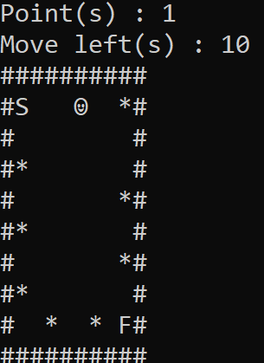
Exercise

Slide 18
Q n A

